Slide 1



INVEST TO
PROTECT
me
Global Week for Action on NCDs
5-11 September 2022 - The Year of NCD Investment
actonncds.org
#ActOnNCDs

Slide 2
INVEST TO
PROTECT
me
Global Week for Action on NCDs
5-11 September 2022 - The Year of NCD Investment
actonncds.org
#ActOnNCDs

Slide 3
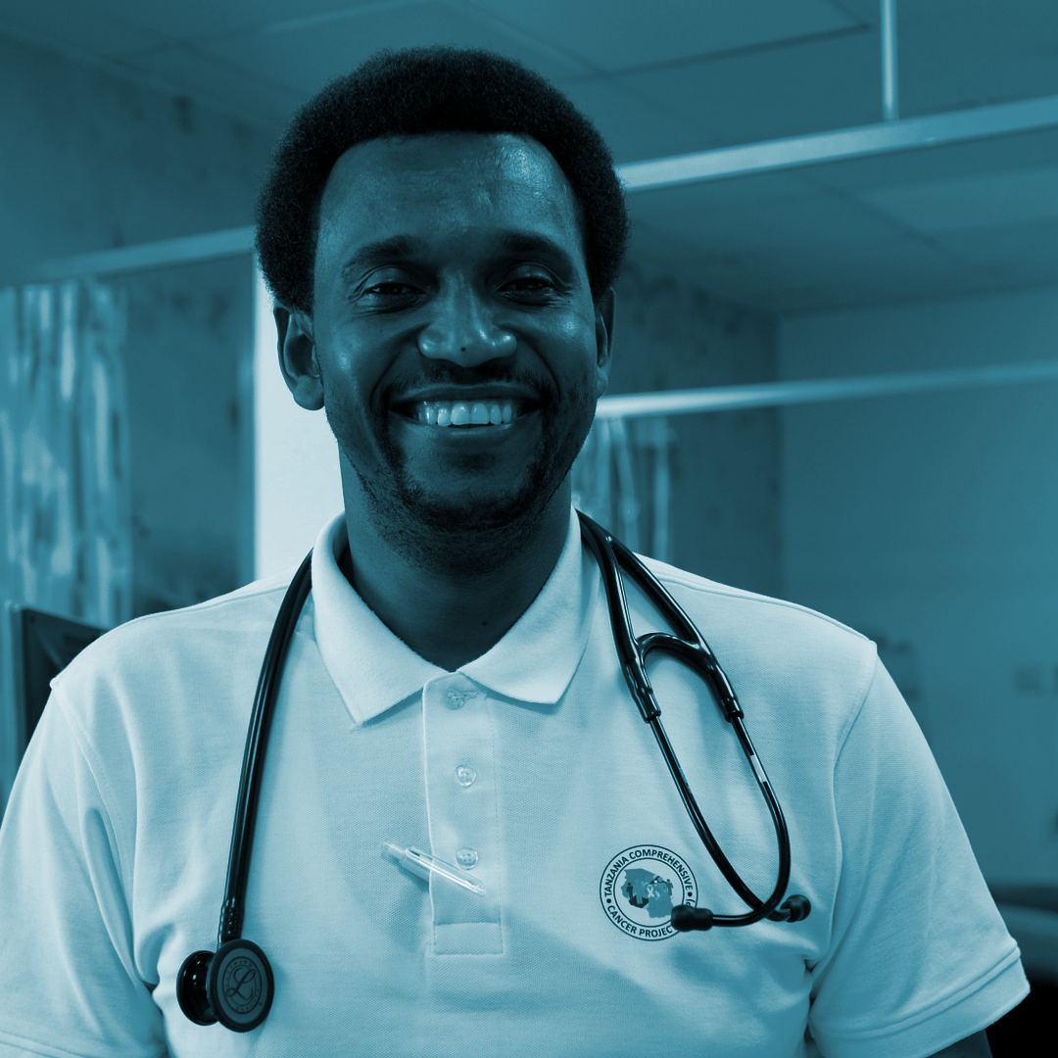
INVEST TO
PROTECT
people
Global Week for Action on NCDs
5-11 September 2022 - The Year of NCD Investment
actonncds.org
#ActOnNCDs

Slide 4

INVEST TO
PROTECT
health
systems
Global Week for Action on NCDs
5-11 September 2022 - The Year of NCD Investment
actonncds.org
#ActOnNCDs

Slide 5
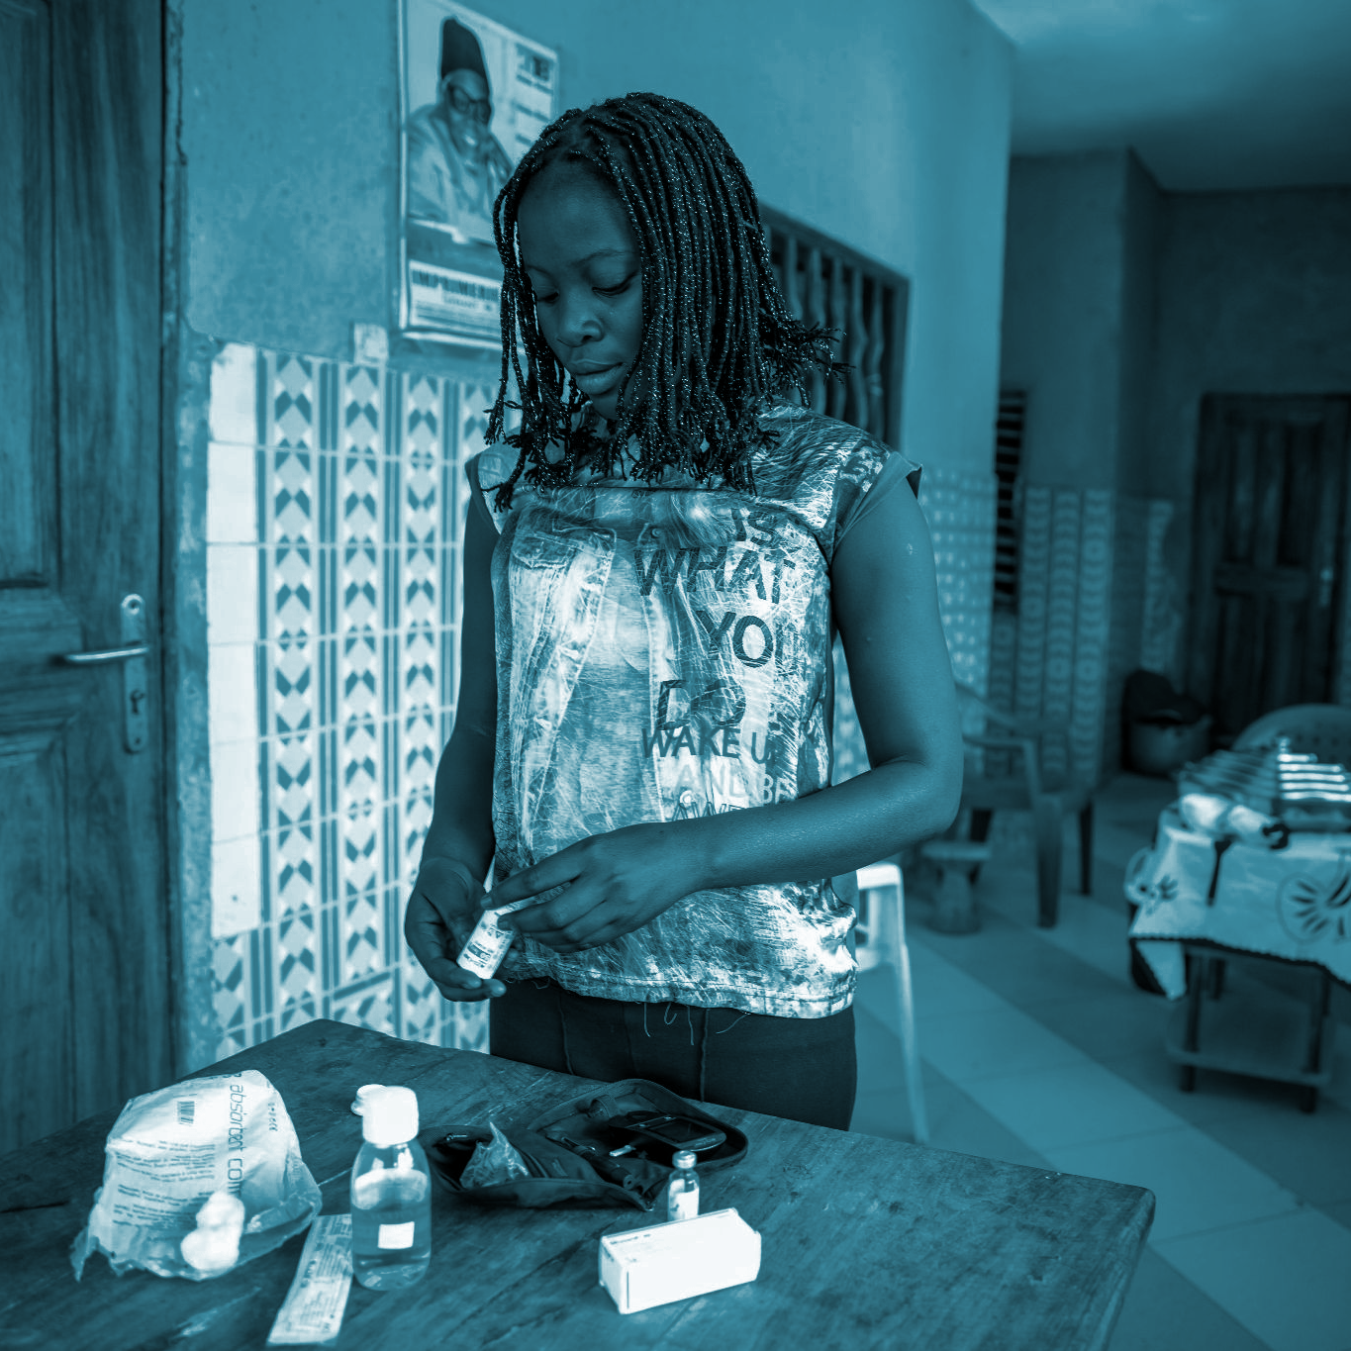
INVEST TO
PROTECT
young people
Global Week for Action on NCDs
5-11 September 2022 - The Year of NCD Investment
actonncds.org
#ActOnNCDs

Slide 6
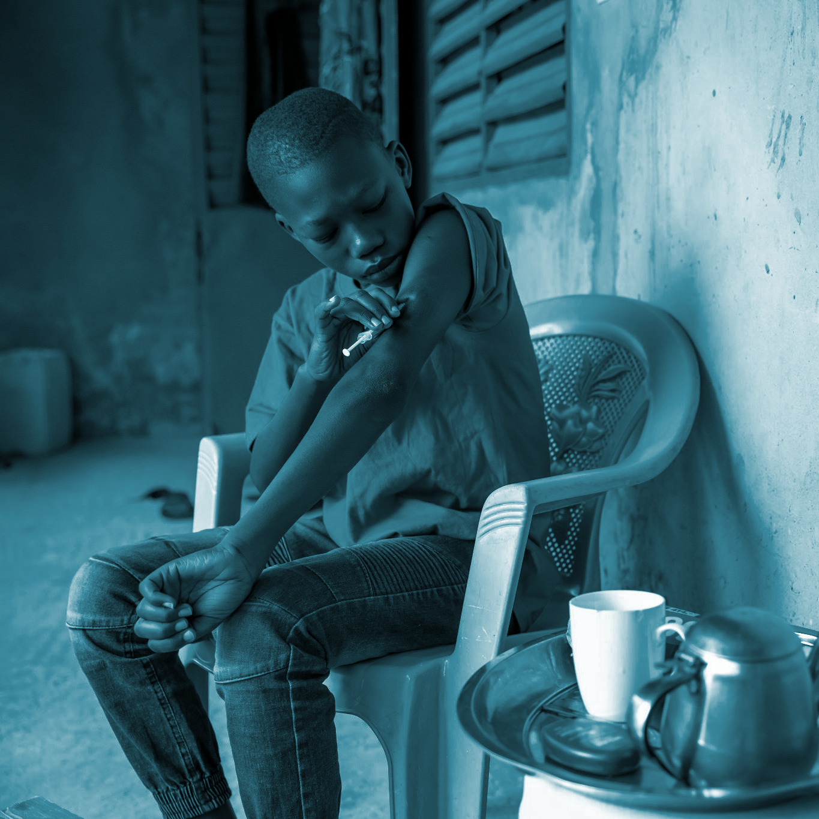
INVEST TO
PROTECT
children
Global Week for Action on NCDs
5-11 September 2022 - The Year of NCD Investment
actonncds.org
#ActOnNCDs

Slide 7
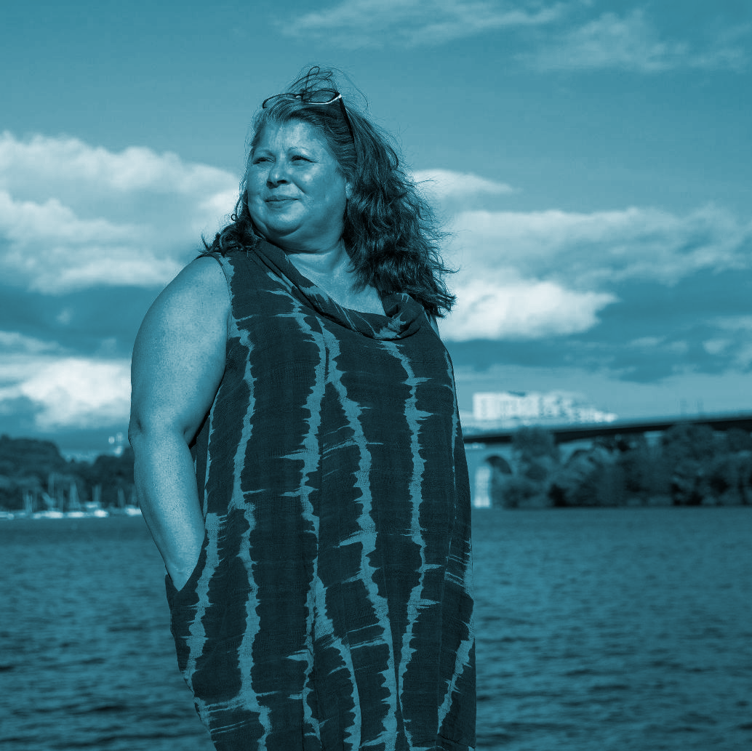
INVEST TO
PROTECT
women
Global Week for Action on NCDs
5-11 September 2022 - The Year of NCD Investment
actonncds.org
#ActOnNCDs

Slide 8
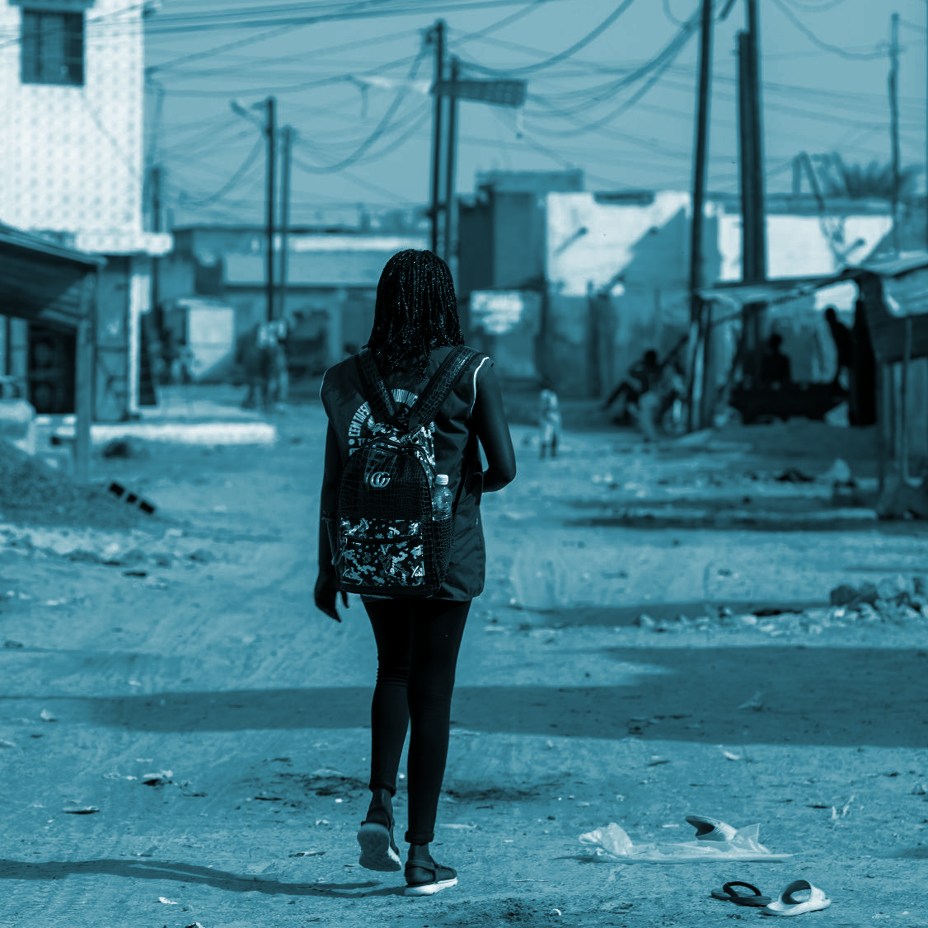
INVEST TO
PROTECT
economies
Global Week for Action on NCDs
5-11 September 2022 - The Year of NCD Investment
actonncds.org
#ActOnNCDs

