Slide 1
Global Week for Action on NCDs
5-11 September 2022 - The Year of NCD Investment
HOW TO CUSTOMISE THESE VISUAL CARDS FOR SOCIAL MEDIA?
PLEASE REMEMBER TO GO TO menu bar above
>> FILE >> Make Copy
Go to your own google drive and edit texts and images directly in your own copy. You can add your organization logo.
Each slide is available in English, French and Spanish. Replace texts and insert new ones with your own translations to other languages.
Once your selected slides/s will be final, download them as .png or .jpg and use it to spread the word on social media. THANK YOU!

Slide 2
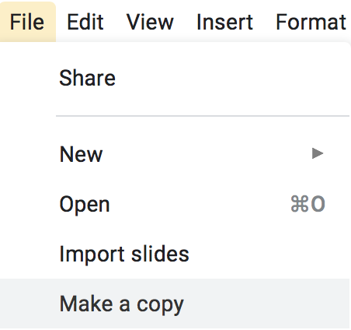
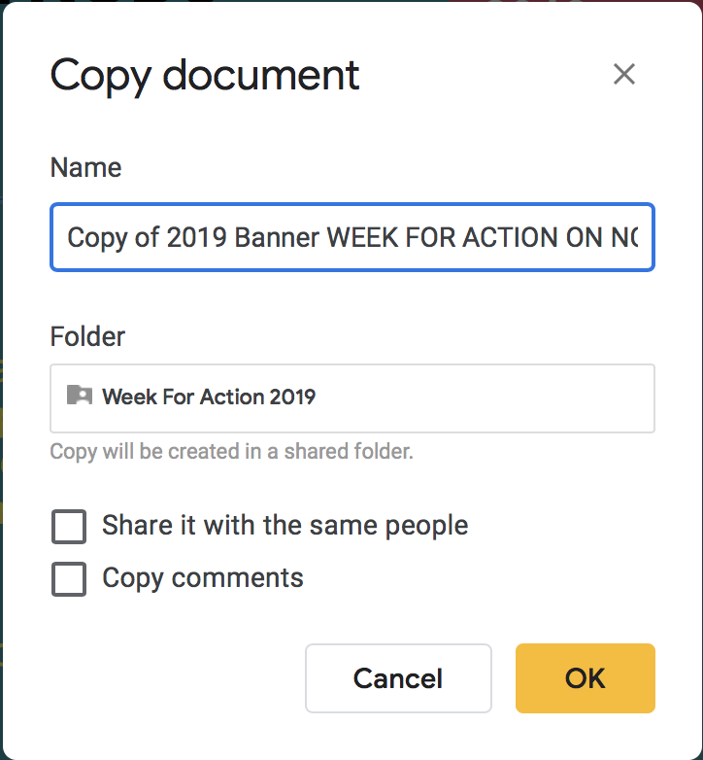
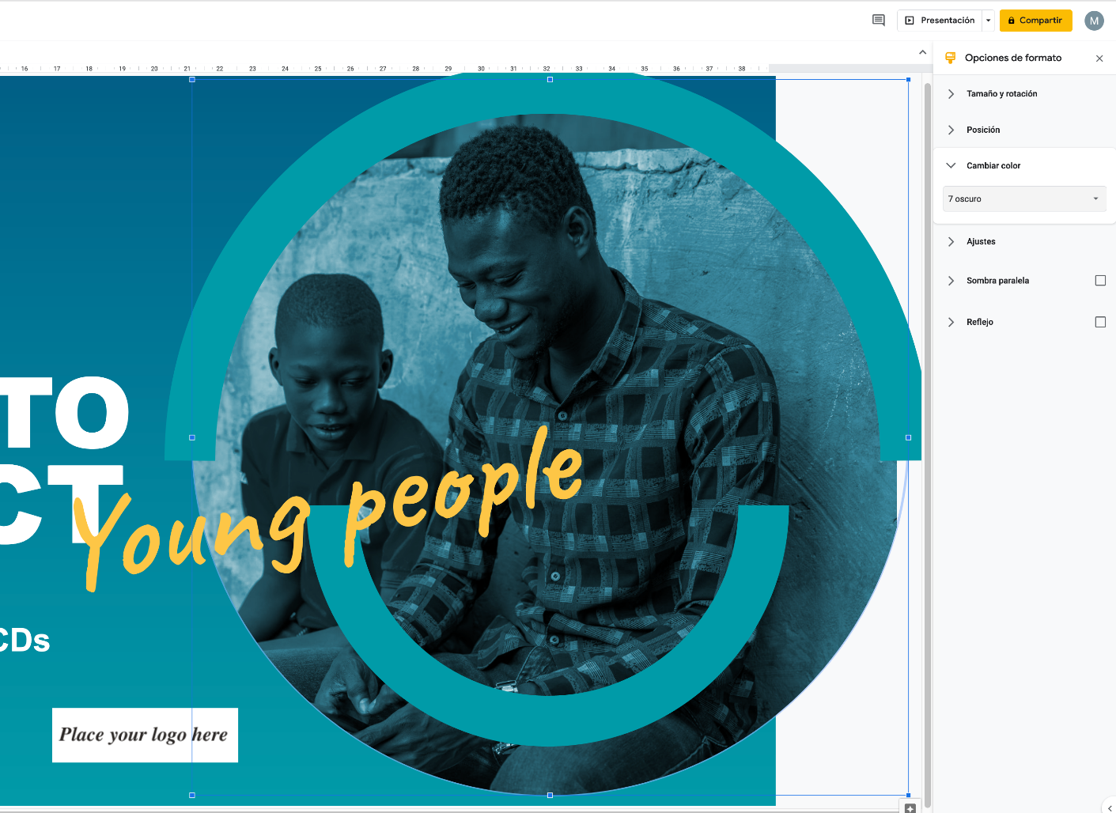
1
2
3
TIPS FOR HOW TO EDIT THE TEMPLATES
Go to the menu bar above & locate File
Under File select ‘Make a copy’. This will open another window or tab. Please save the file in a name of your choice i.e. Act on NCDs Banner [organisation name]
Edit the templates directly in your own copy on google drive.
Add your organisation’s logo A. INSERT image where the placement is indicated and delete the “Place your logo here”
B. Select the placement graphic and choose REPLACE image from the FORMAT menu. C. COLORIZED the image To adjust image size select and drag the blue corners of the blue selection box. To adjust cropping double-click the image and use the black bounding box. This method can also be used to replace other images.
Once finished, select the slide you want to use, go to FILE in the menu and download to your computer as a JPG or take and save a screen shot.
4
5

Slide 3
INVEST TO
people
PROTECT
Global Week for Action on NCDs
5-11 September 2022 - The Year of NCD Investment
#ActOnNCDs

Slide 4
INVEST TO
PROTECT
health systems
Global Week for Action on NCDs
5-11 September 2022 - The Year of NCD Investment
#ActOnNCDs

Slide 5
INVEST TO
PROTECT
health systems
Global Week for Action on NCDs
5-11 September 2022 - The Year of NCD Investment
#ActOnNCDs
Notes:
Slide for Invest to Prevent Future Pandemics

Slide 6
INVEST TO
health workers
PROTECT
Global Week for Action on NCDs
5-11 September 2022 - The Year of NCD Investment
#ActOnNCDs

Slide 7
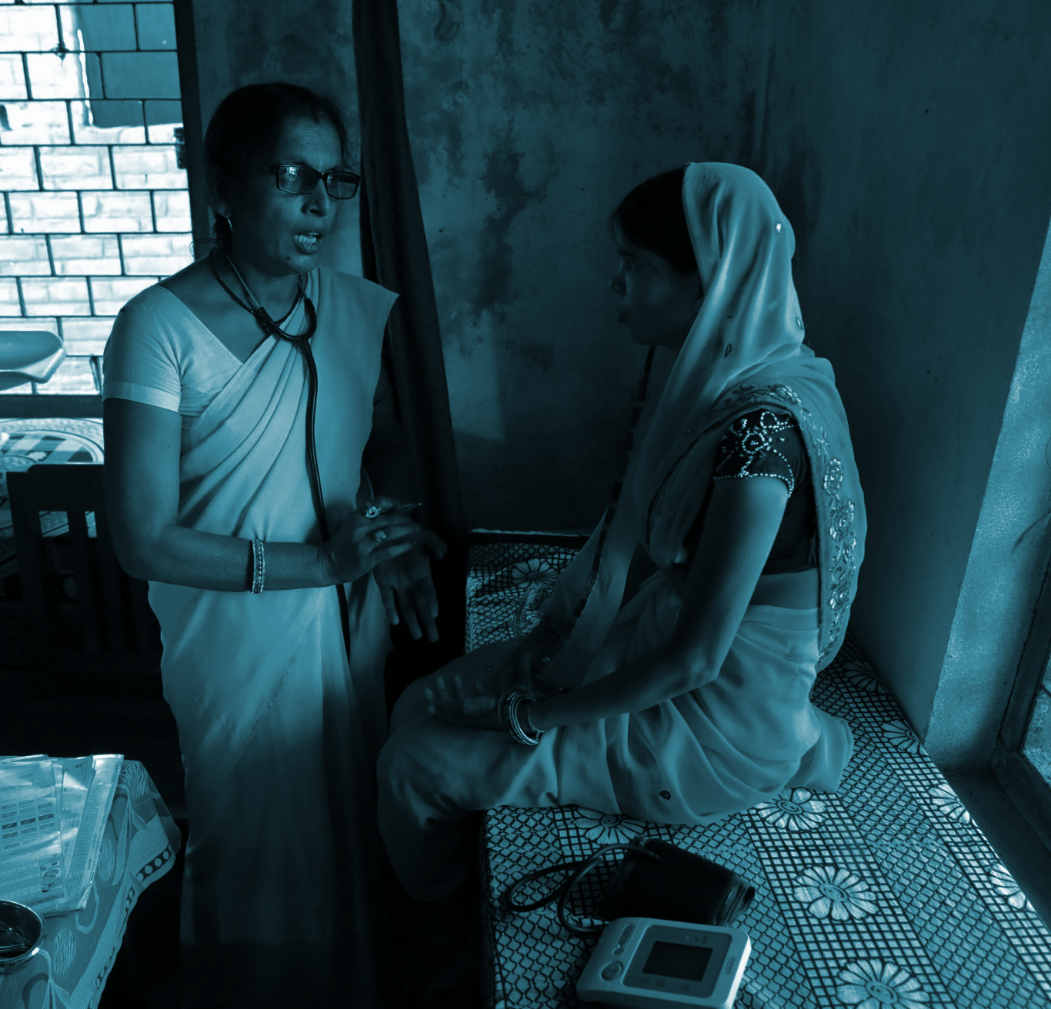
INVEST TO
health workers
PROTECT
Global Week for Action on NCDs
5-11 September 2022 - The Year of NCD Investment
#ActOnNCDs

Slide 8
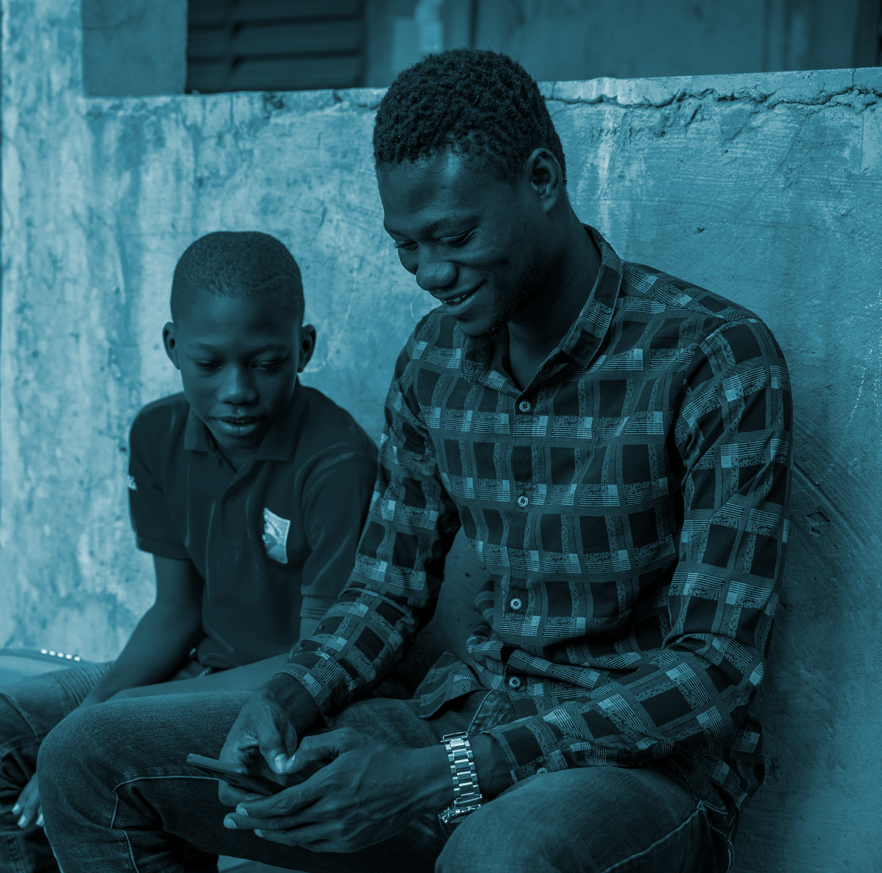
INVEST TO
young people
PROTECT
Global Week for Action on NCDs
5-11 September 2022 - The Year of NCD Investment
#ActOnNCDs

Slide 9
INVEST TO
young people
PROTECT
Global Week for Action on NCDs
5-11 September 2022 - The Year of NCD Investment
#ActOnNCDs

Slide 10
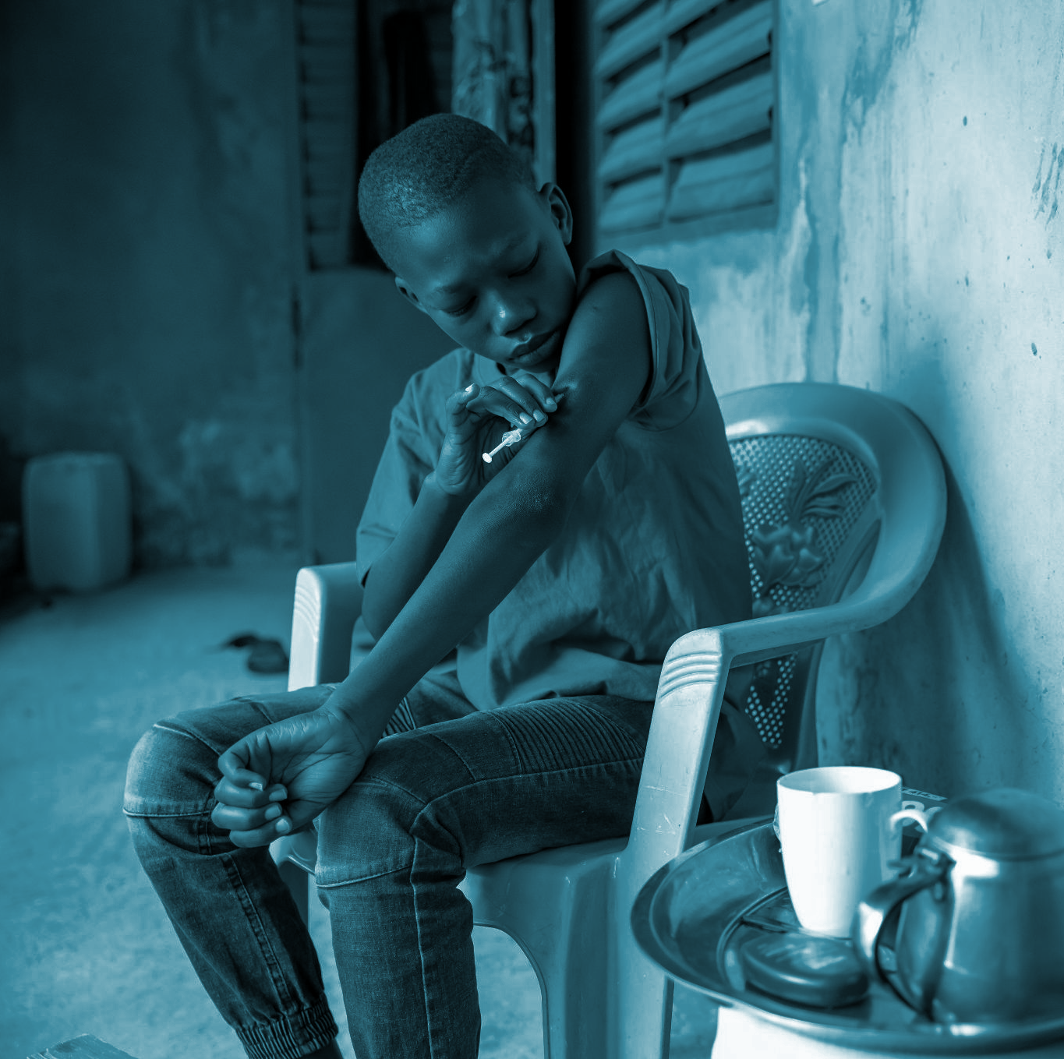
INVEST TO
children
PROTECT
Global Week for Action on NCDs
5-11 September 2022 - The Year of NCD Investment
#ActOnNCDs

Slide 11
INVEST TO
Children
PROTECT
Global Week for Action on NCDs
5-11 September 2022 - The Year of NCD Investment
#ActOnNCDs

Slide 12
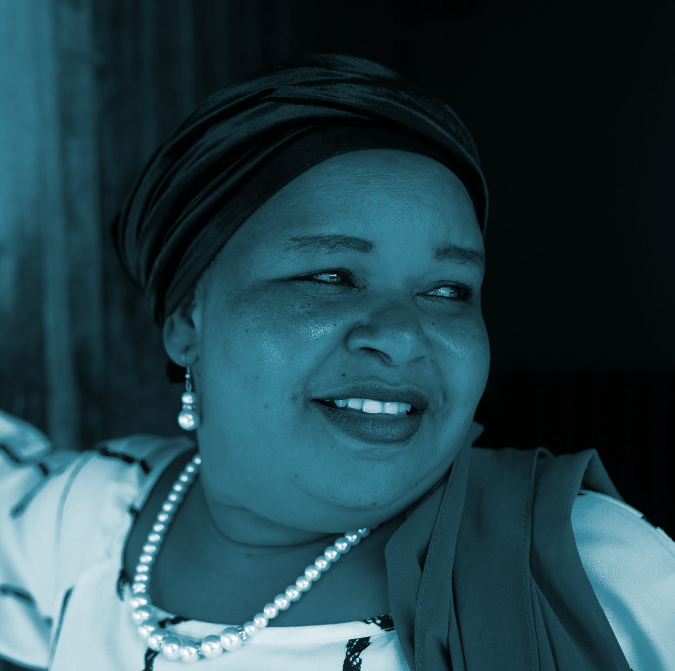
INVEST TO
women
PROTECT
Global Week for Action on NCDs
5-11 September 2022 - The Year of NCD Investment
#ActOnNCDs

Slide 13
INVEST TO
women
PROTECT
Global Week for Action on NCDs
5-11 September 2022 - The Year of NCD Investment
#ActOnNCDs

Slide 14
INVEST TO
PROTECT
economies
An investment of under $1 per person per year in cost-effective measures to prevent and treat NCDs could save 7 million lives in low- and middle-income countries by 2030.
Global Week for Action on NCDs
5-11 September 2022 - The Year of NCD Investment
#ActOnNCDs

Slide 15
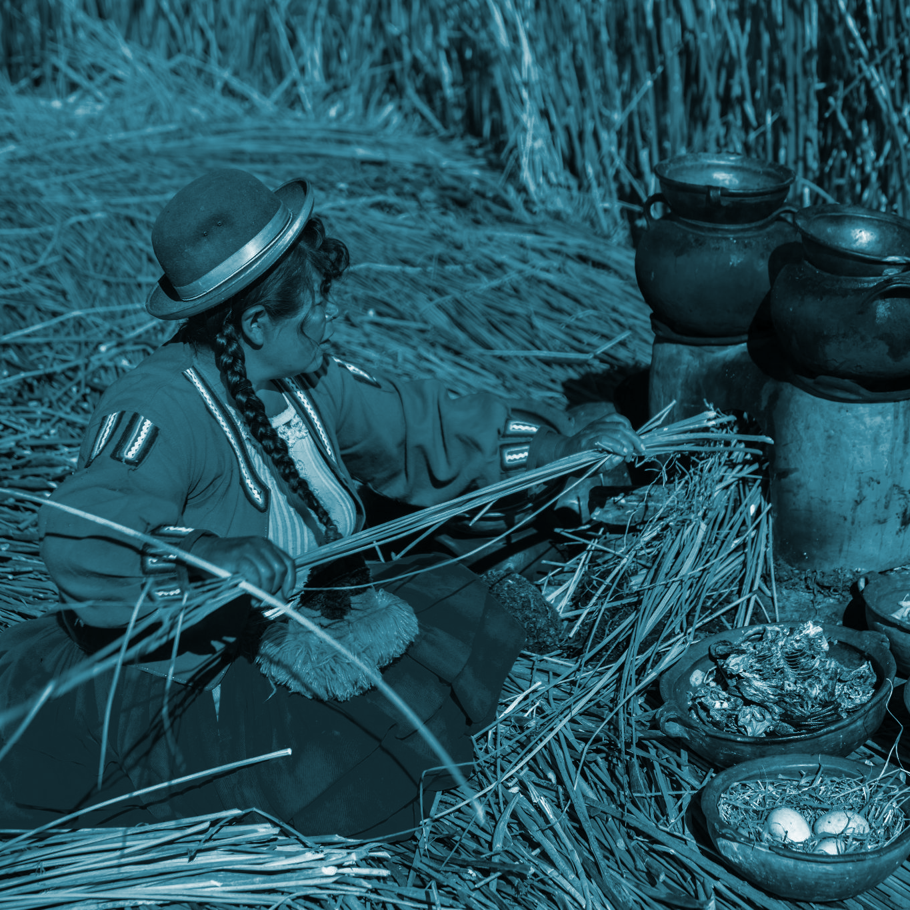
INVEST TO
PROTECT
economies
An investment of under $1 per person per year in cost-effective measures to prevent and treat NCDs, could save 7 million lives in low- and middle-income countries by 2030.
Global Week for Action on NCDs
5-11 September 2022 - The Year of NCD Investment
#ActOnNCDs

Slide 16
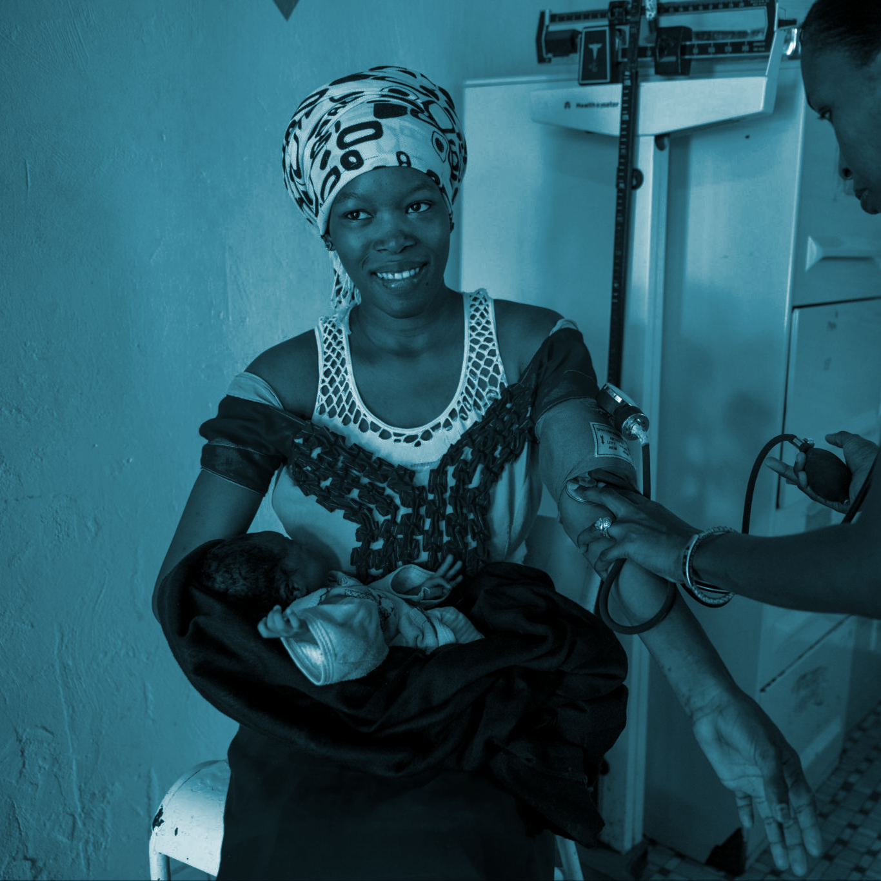
INVEST TO PROTECT
GOVERNMENTS: HERE’S HOW YOU CAN
economies
Incorporate NCDs into universal health coverage, national health insurance and social protection schemes.
Global Week for Action on NCDs
5-11 September 2022 - The Year of NCD Investment
#ActOnNCDs

Slide 17
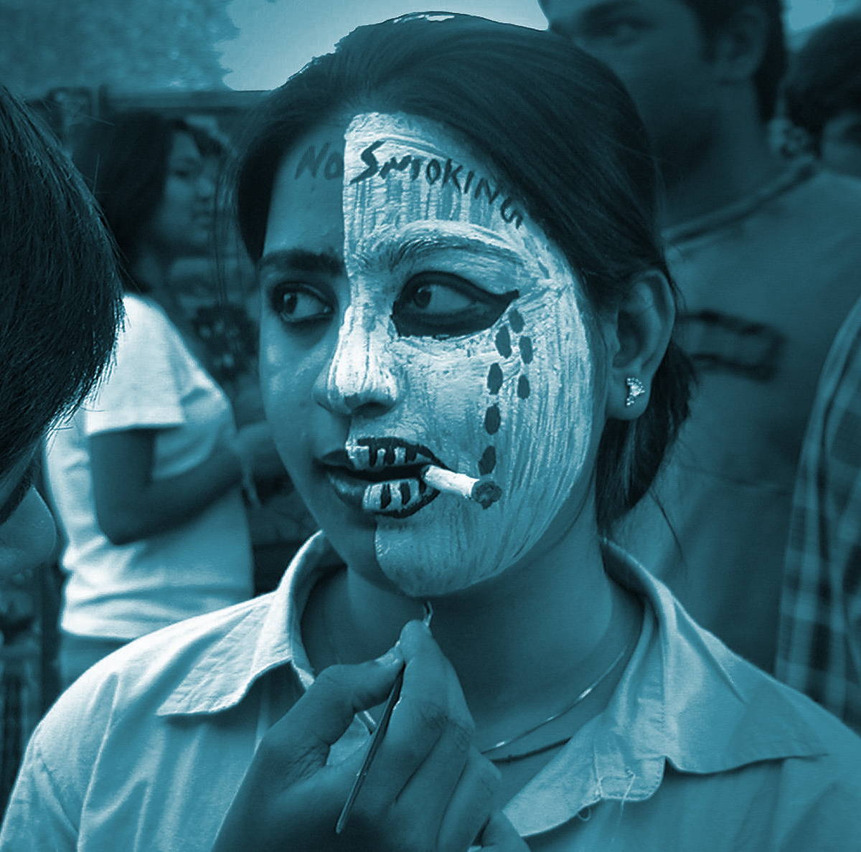
INVEST TO PROTECT
GOVERNMENTS: HERE’S HOW YOU CAN
economies
Phase out promotion of unhealthy products like tobacco, alcohol, fossil fuels and ultra-processed food and drinks.
Global Week for Action on NCDs
5-11 September 2022 - The Year of NCD Investment
#ActOnNCDs

Slide 18
INVEST TO PROTECT
GOVERNMENTS: HERE’S HOW YOU CAN
people
Strengthen evidence on investment case for NCDs through data and regular reporting.
Global Week for Action on NCDs
5-11 September 2022 - The Year of NCD Investment
#ActOnNCDs

Slide 19
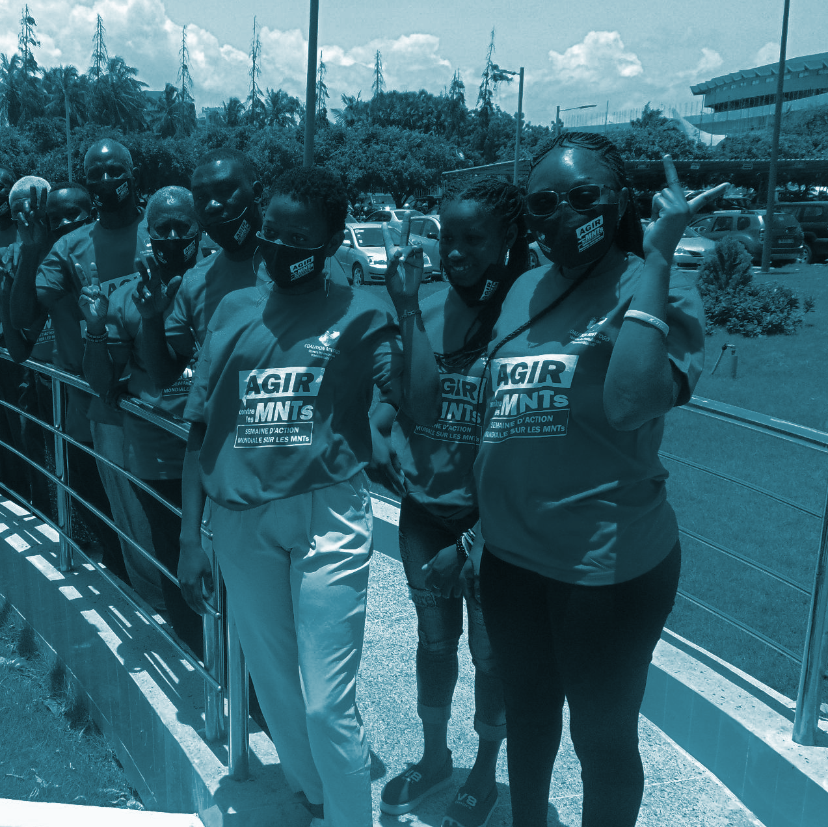
INVEST TO PROTECT
GOVERNMENTS: HERE’S HOW YOU CAN
people
Promote best practice, solutions policy research of NCD financing at national and regional levels.
Global Week for Action on NCDs
5-11 September 2022 - The Year of NCD Investment
#ActOnNCDs

